Slide 1

Build the Enlightened Enterprise
An Overview of the JBoss BPM Suite
& JBoss FSW Integration Demo
Powered by Red Hat JBoss Middleware:
JBoss BPM Suite v6
JBoss FSW v6
TITLE SLIDE: HEADLINE
Presenter name
Title, Red Hat
Date

Slide 2
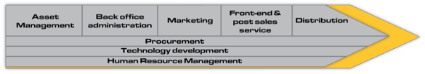













JBoss Middleware becomes strategic
STRATEGY
PROCESSES
OPERATIONS
PEOPLE IT RESOURCES
Notes:
BPM Suite helps organizations to model and automate business processes combining people, data and applications, in all scenarios, from traditional to open hybrid cloud.

Slide 3

Components in project

Slide 4







Value Proposition
Automate
business operations
with intelligent
decision support
Optimize
business operations
with real-time BAM, analytics,
simulation and reccomendation
Accelerate
application development
with model-driven
design and integration
AHA!
HYBRID CLOUD
PRIVATE
CLOUD
PUBLIC
CLOUD
Empower
business users to
take control of operations
Collaborative working
during the entire process life cycle
and beyond the Enterprise
Deploy
in the Cloud
with BPM PaaS

Slide 5





Capabilities Overview
Processes Create and deploy enterprise processes and applications through a model-driven composition environment and execution platform. | Services Integrate and interoperate your existing enterprise systems and web services in your business processes using JBoss SOA Platform and JBoss Fuse modern ESB.
Rules JBoss BRMS is included in JBoss BPM Suite to support the definition, management and execution of business rules by Business and IT users. | Data Data modeling tool that also enables participants to manipulate and manage data entities within running processes.
Events Handle events as first class citizens of the platform, dedicating an independent module to Manage Complex Event Processing (CEP). | Forms Forms modeling tool to build dynamic and interactive web forms using using a WYSIWYG drag-and-drop interface.

Slide 6







Capabilities Overview
Analytics Build dashboards that deliver real-time business activity monitoring (BAM) and reporting with personalized information, measure and analyze key indicators to track process performance to make quick and effective decisions. | Simulation Establish, execute and analyse different simulation scenarios. Identify bottlenecks. Decide what are the optimal parameters and thresholds for your processes. Make effective recommendations.
Assets Pluggable multi-dimensional repository for knowledge representation of processes, rules, data and services to facilitate reusability, change management, governance and compliancy. | Workspace The execution environment provides a Rich User Interface (RUI) or Portal that centralize user participation, attending alerts and triggers, and notifying actions to each role across the entire process lifecycle.
Execution Integrated execution environment with separates engines for processes, tasks, evente and rules. Deploy in different application servers, on-premise or in cloud. | Development JBoss Workbench IDE lets developers easily extend, build and integrate process-based applications.

Slide 7






Full BPM lifecycle support
Modeling & Simulation
Integration & Deployment
Continuous Improvement
Monitoring & Analysis
Execution & Management

Slide 8
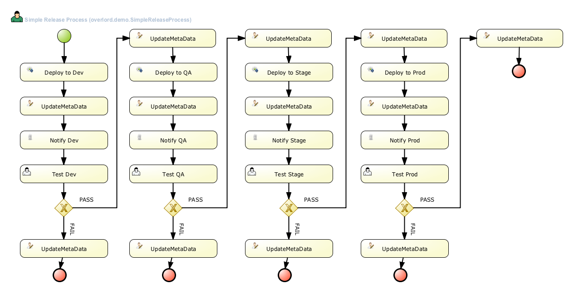
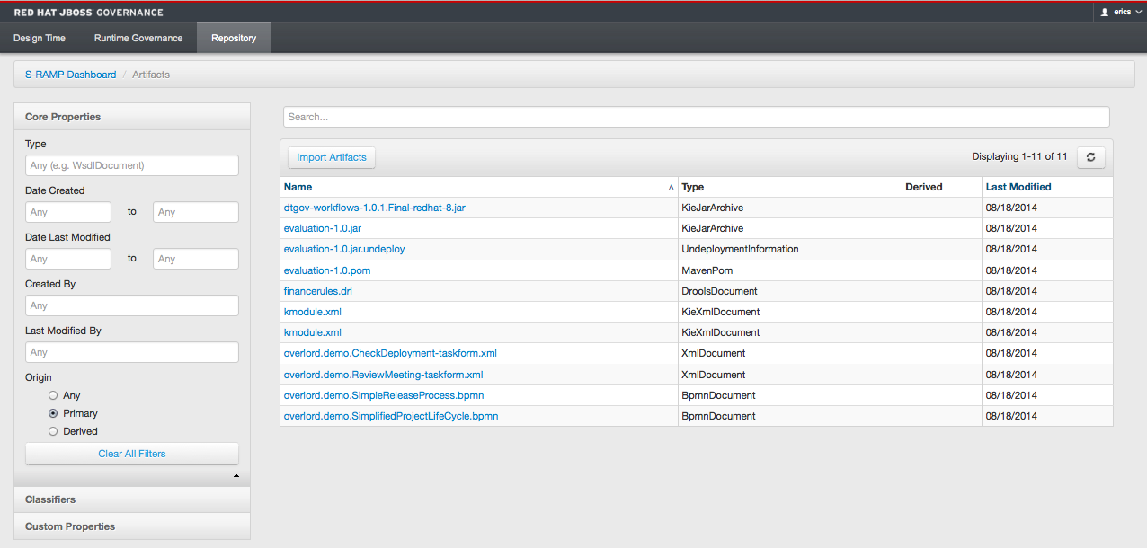
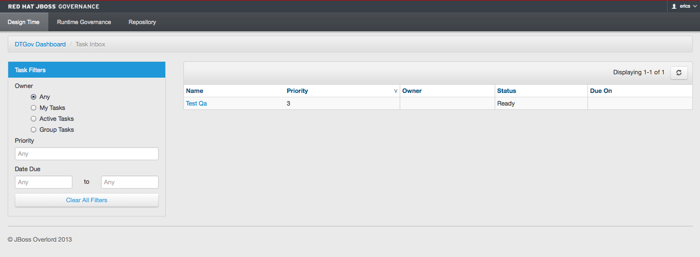
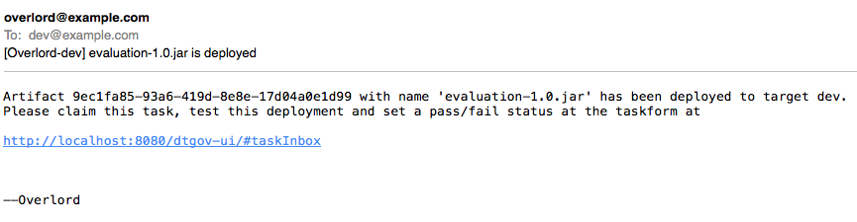
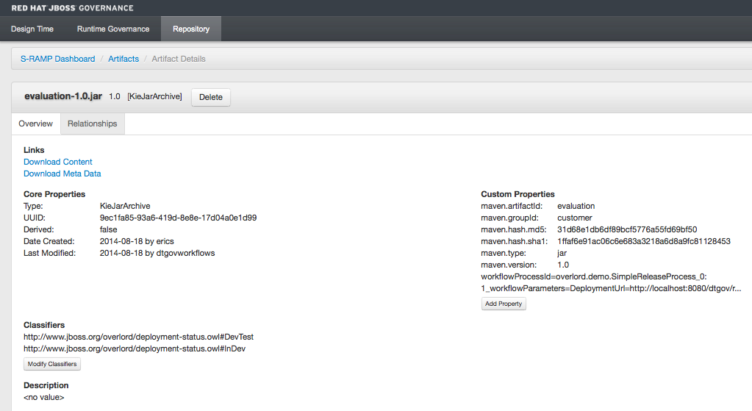
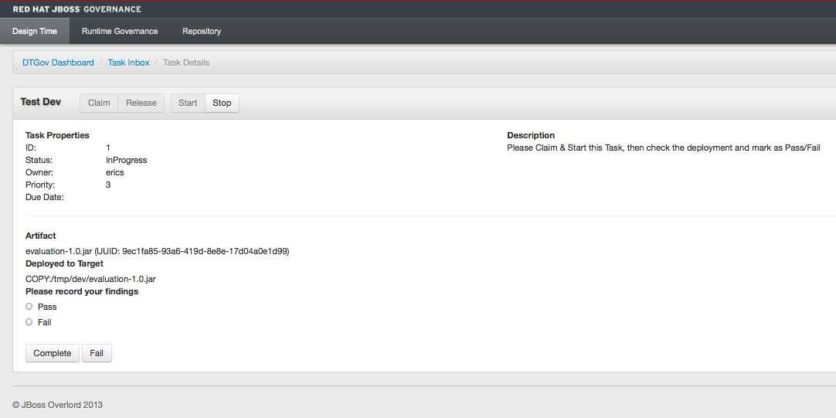
BPM Governance with FSW & S-RAMP

Slide 9
Overview of Fuse service works

Slide 10
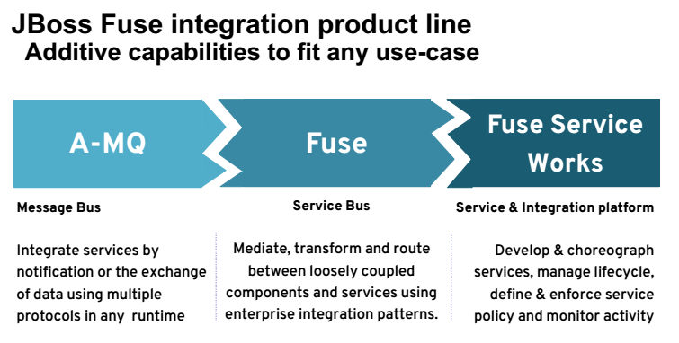

Slide 11
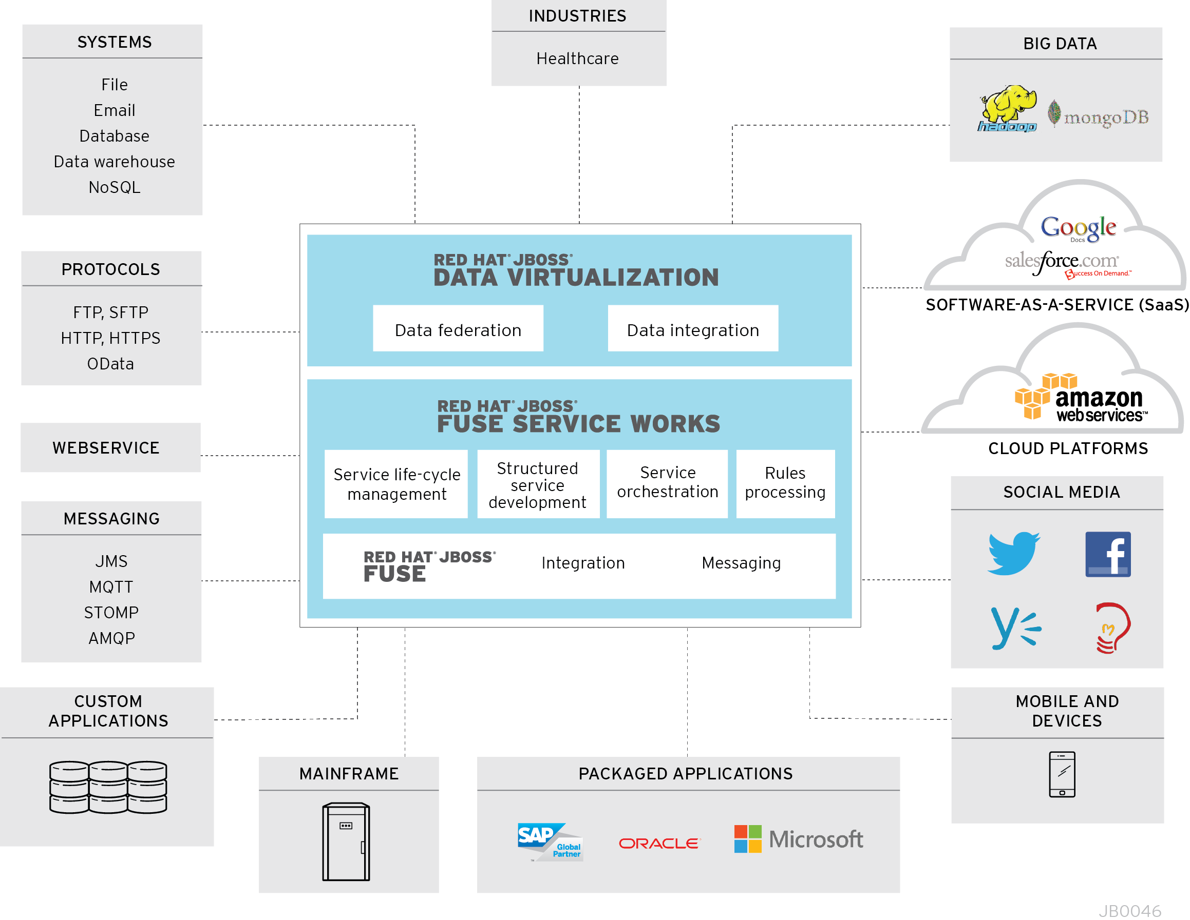
JBoss Middleware – Multiple Connectivity Options

Slide 12
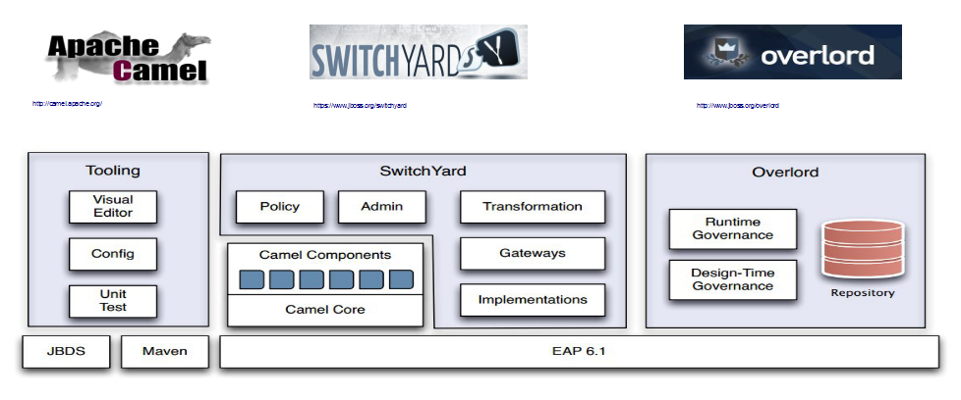
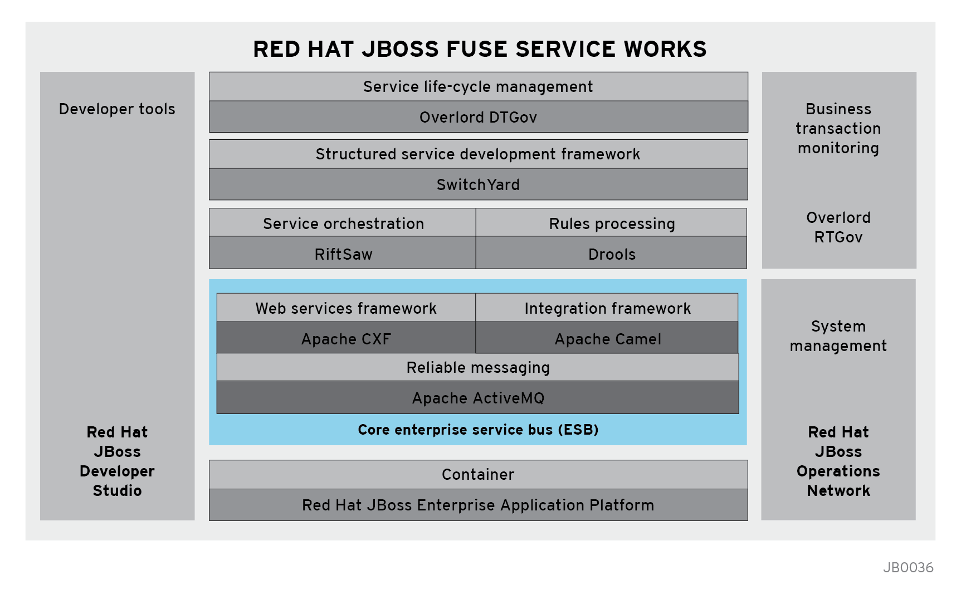
A service design, development and integration platform that enables organizations to transition to open hybrid cloud

Slide 13
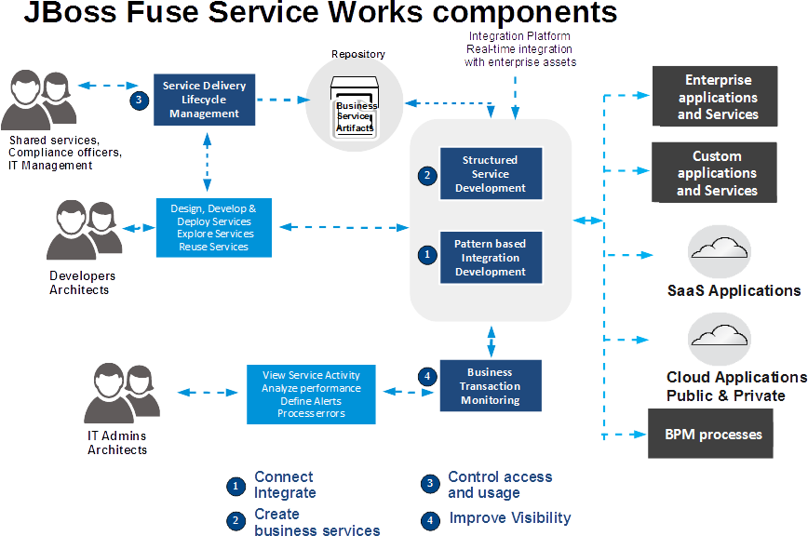

Slide 14
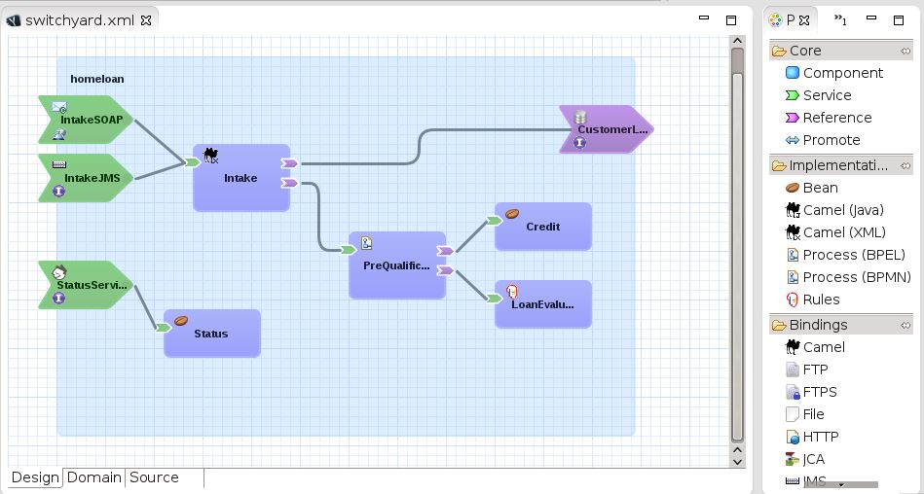
Switchyard
Lightweight, SCA-based, structured
service development framework
Design, code, test at higher service
abstraction
Store and reuse business services - shared repository
Easily call BPMN based BPM processes
Visual Tooling: Model is the application

Slide 15
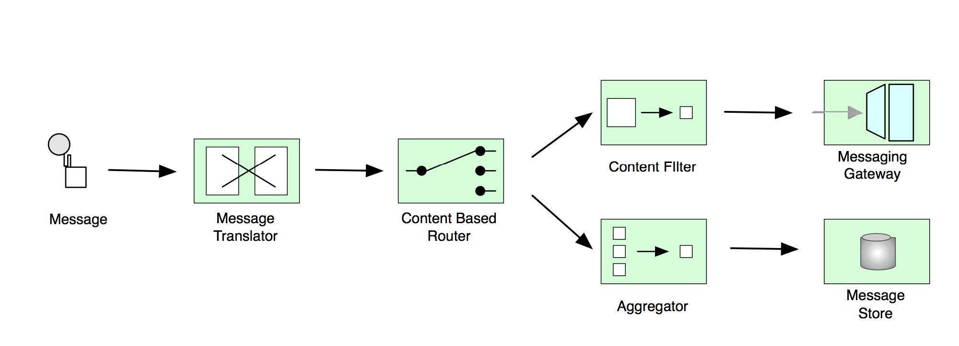
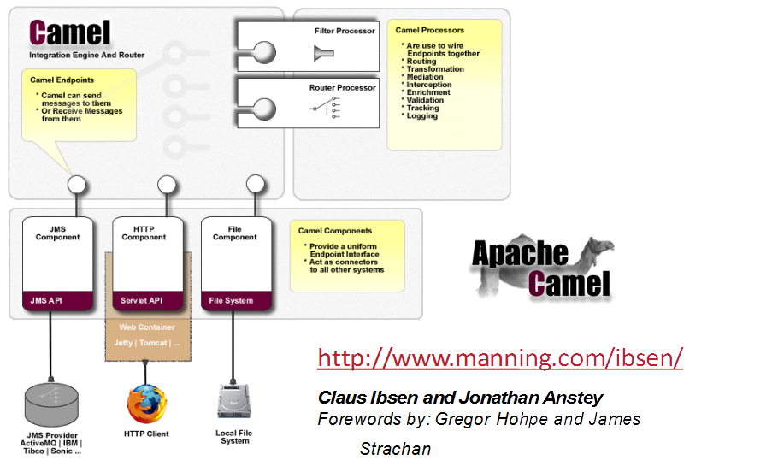

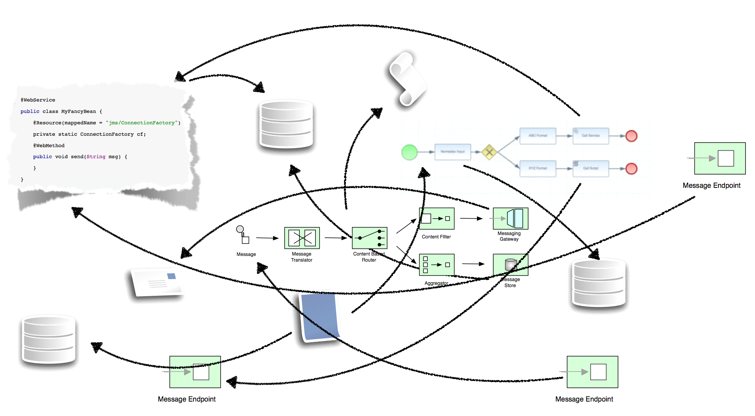
Camel
      Simplicity is good

Slide 16
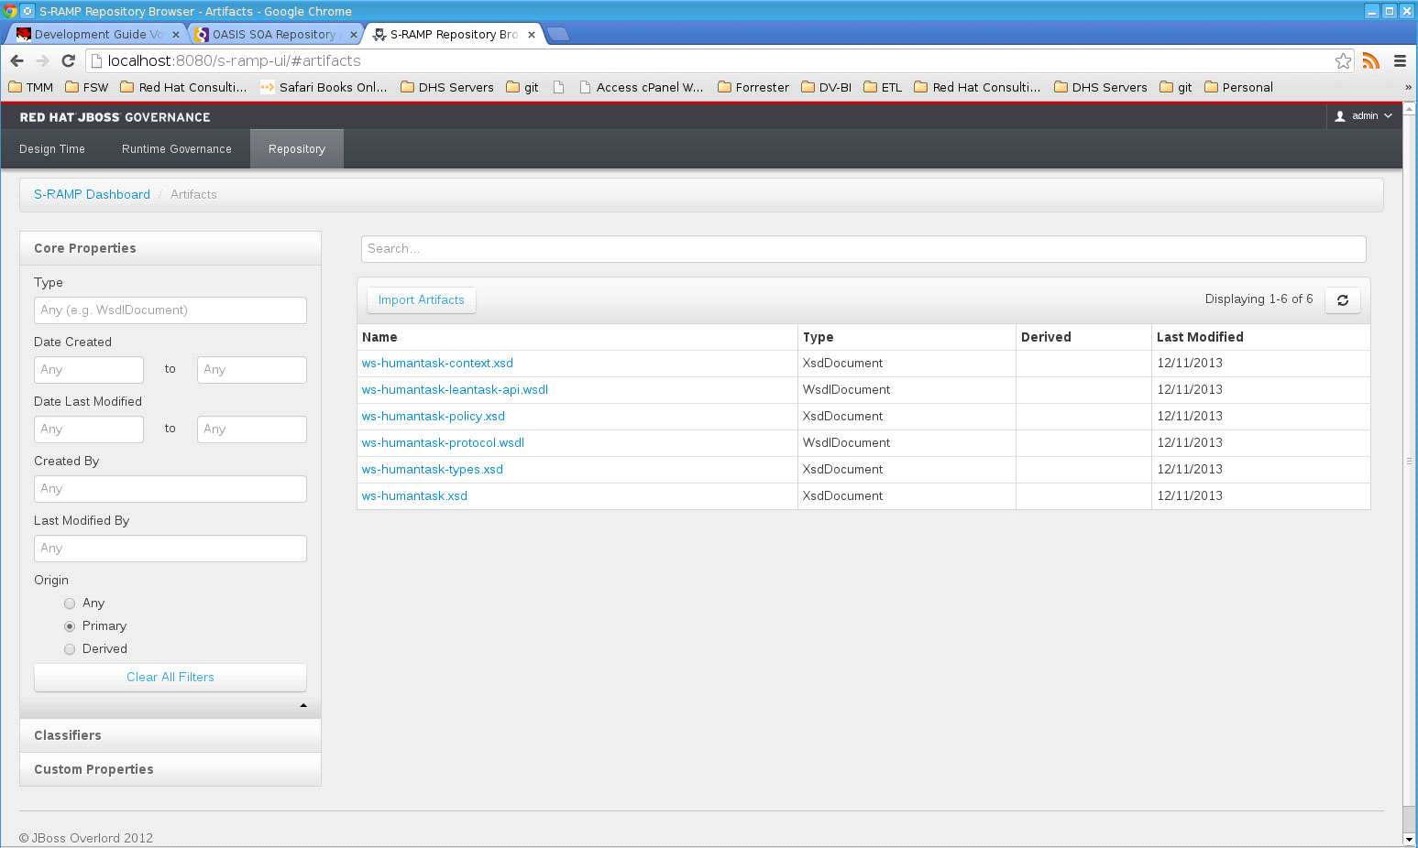
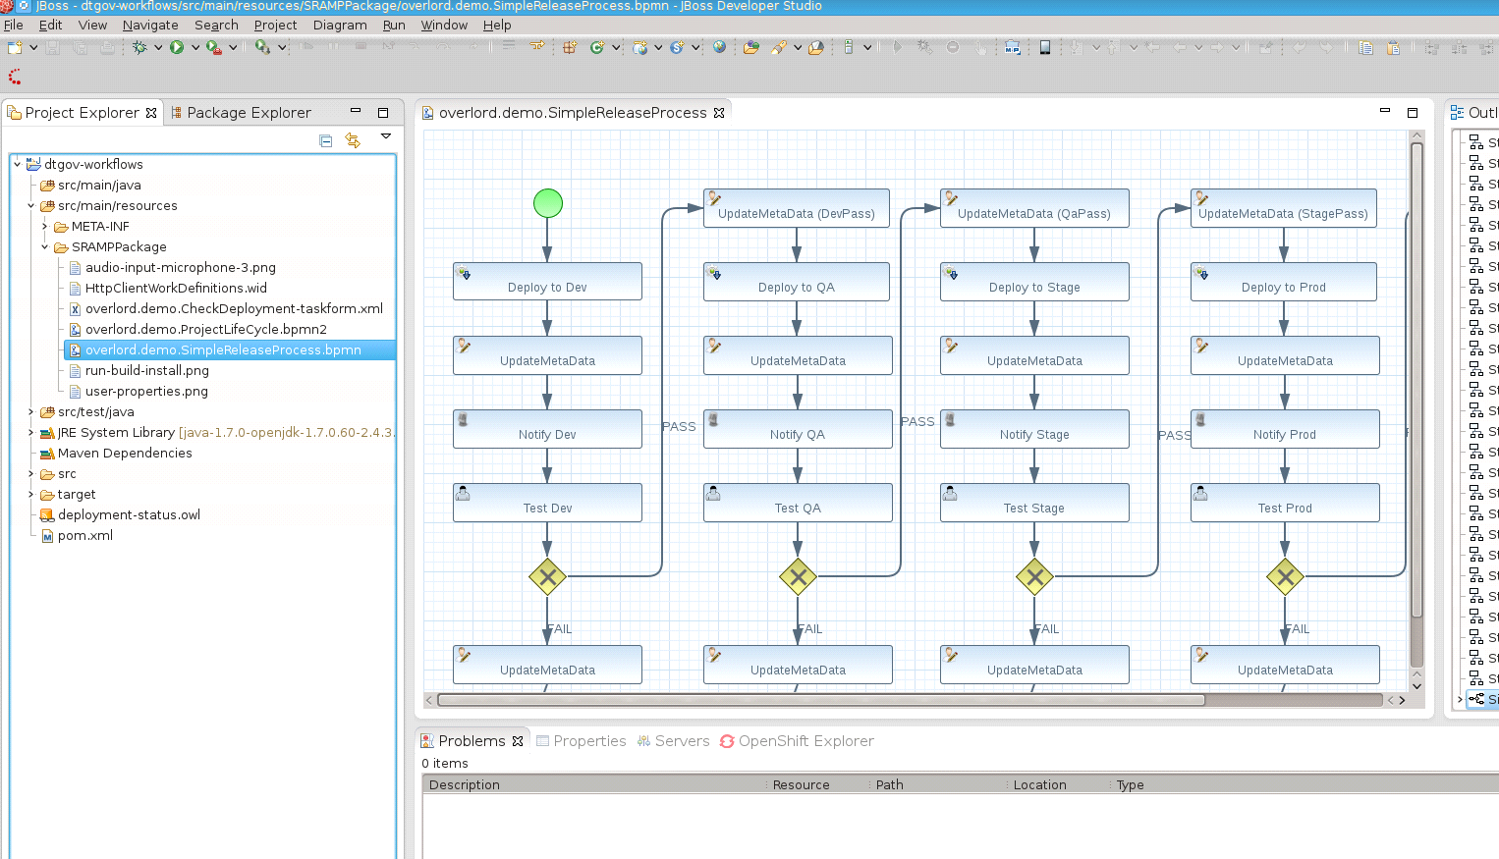
Overlord Design Time Governance
Service component and artifact registry (S-RAMP)
Store, share services/policies across teams
Team Notifications on content changes
Track and Visualize artifact relationships
Impact Discovery & Analysis
Web and CLI tools to simplify search and reporting

Slide 17
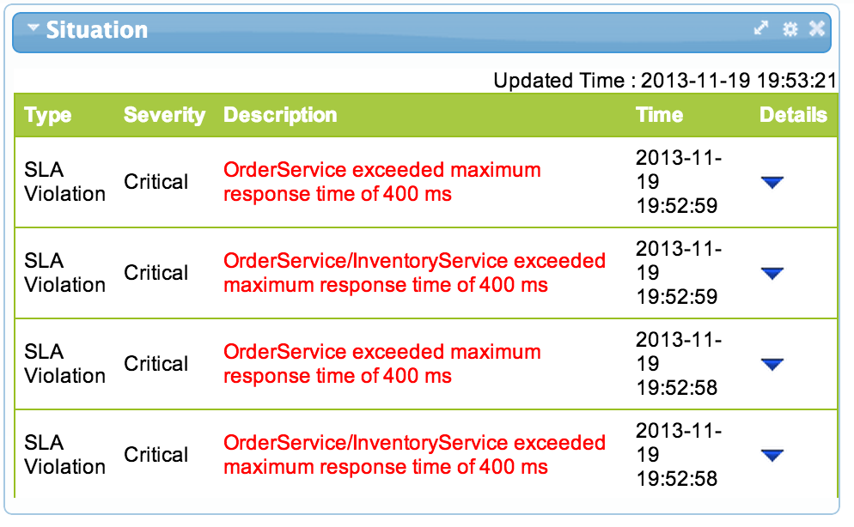
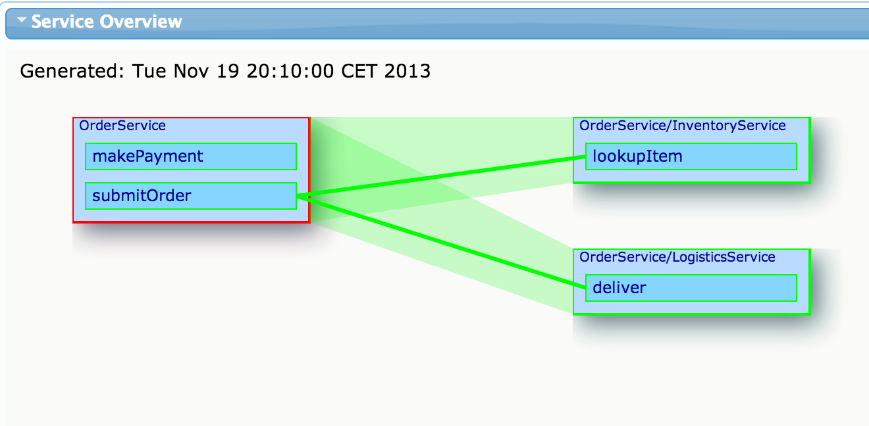
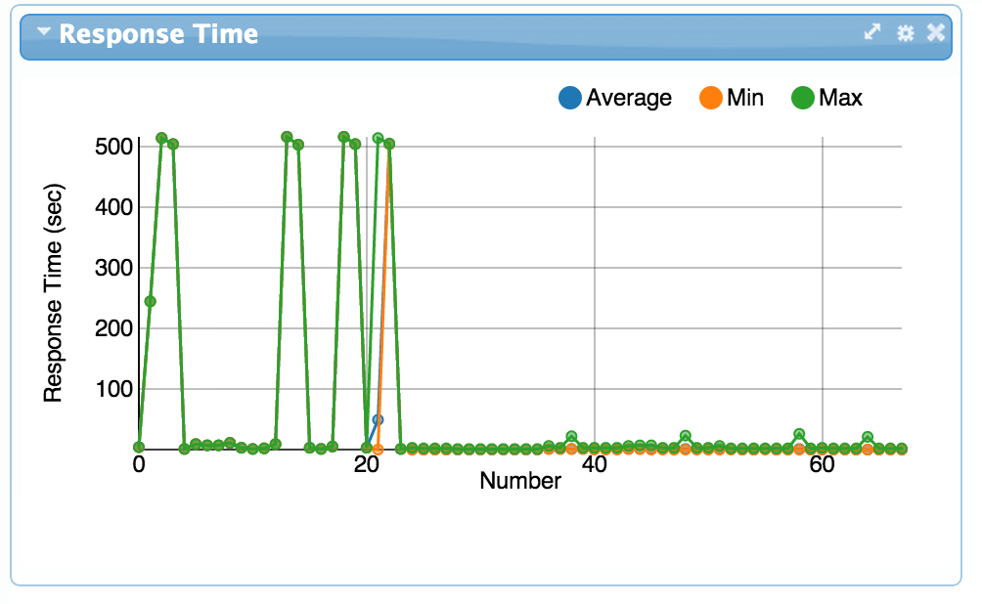
Overlord Run Time Governance
Grow service quality
SLA enforcement, alerting and real-time transaction monitoring
Realize IT Agility
Independently manage SLA and runtime policy from service definition.
Increase operational visibility
Identify precisely where,why and how transactions are delayed
by track SLA violations
Understand and measure operational efficiency
Long term storage of operational data to support analysis & optimization
Notes:
RTGov is operational infrastructure, user API and visual dashboard.
Monitor, capture, correlate, analyze, alter transactions spanning multiple services and systems

Slide 18
Build the Enlightened Enterprise
For more information, please visit
http://www.jboss.com
Demo project available at:
http://github.com/eschabell/bpms-fsw-integration-demo
TITLE SLIDE: HEADLINE
Presenter name
Title, Red Hat
Date

